Slide 1
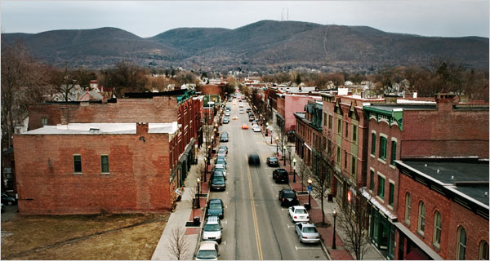
Welcome to Town Government:
An Overview Of Town Government and Administration
Sarah Brancatella, Esq.
The Association of Towns of the State of New York
Michael E. Kenneally, Jr., Esq.
The Association of Towns of
the State of New York

Slide 2
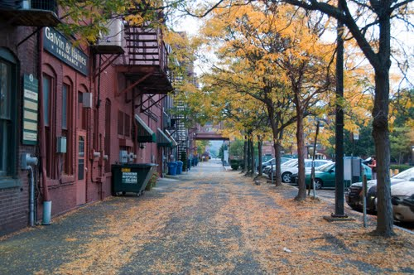
Town Government
Towns are general purpose local governments that operate in accordance with the constitution and laws of NYS.
Laws created by statute (Legislature) or common law (courts).
“Local government” includes counties, cities, towns and villages (NYS Const. Article IX, General Municipal Law § 2).
General purpose local governments have authority to regulate conduct, provide services, and tax.

Slide 3
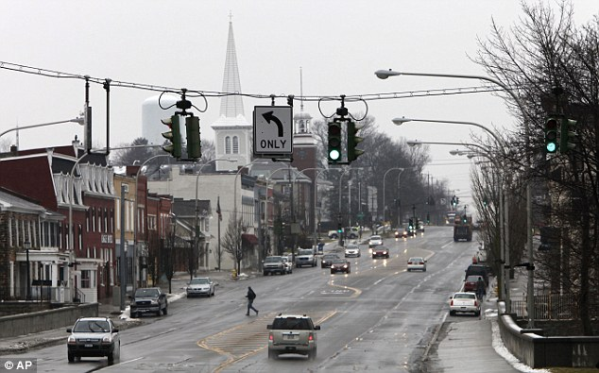
Town Government
Two classifications of towns:
Second class (820 in number)
First class (112 in number)
Classified primarily by population and / or assessed valuation.
All but smallest towns have option to change to first class.
Towns provide same essential services regardless of classification.
May account for some differences in town offices etc.

Slide 4
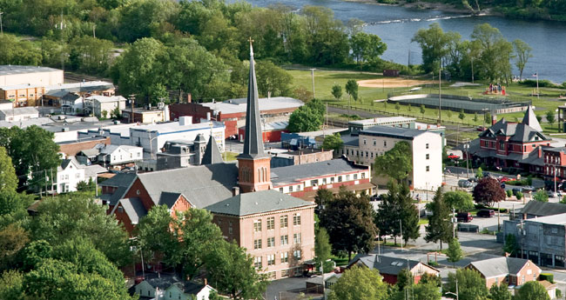
Town Services
Town services are provided:
Town Wide: Services provided to all areas of town, including those in village(s) or special district.
Part-town (Town Outside Village or TOV): Services provided to area of town outside any villages.
Special District: Services provided only to those residing in special district.

Slide 5
Town Services (No Villages)
Town wide Services
Highway Maintenance and Repair
Assessments
Police
Planning / Zoning
Services provided to entire area of town
Town

Slide 6
Part-Town / TOV
When a town has one or more villages, certain services are provided only to area of town outside of any incorporated villages (TOV).
Common Part-Town Services
Planning & Zoning
Highway Maintenance and Repair

Slide 7
Town Services (With Village)
Town Wide Services
Police
Assessment
TOV / Part-town Services
Planning / Zoning
Highway Repair and Maintenance
Town Outside Village
Village

Slide 8
District Services
Districts provide a particular service:
Water
Sewer
Fire Protection
Only those residing in district receive service.
Only those residing in district pay for service.

Slide 9
Administrative Structure
Town Board
Fiscal Affairs
Permits and Records
Highway Administration
Planning / Zoning
Personnel
Miscellaneous
Tax Assessment and Collection
Town Supervisor
Assessor
Board of Assessment
Review
Collecting Officer
Superintendent of Highways
Animal Control
Parks & Recreation
Police
Special District
Planning Board
Zoning Board of Appeals
Code Enforcement
Department Heads
Town Supervisor
Town Clerk

Slide 10
Town Board
Legislative body - adopts local laws, ordinances and resolutions
Responsible for overall administration of town
Control of town finances, budget and property
Authorizes and approves all purchases and contracts entered into by town
Appoints officers and employees, sets salaries
Sets policy
Creates and administers improvement districts

Slide 11
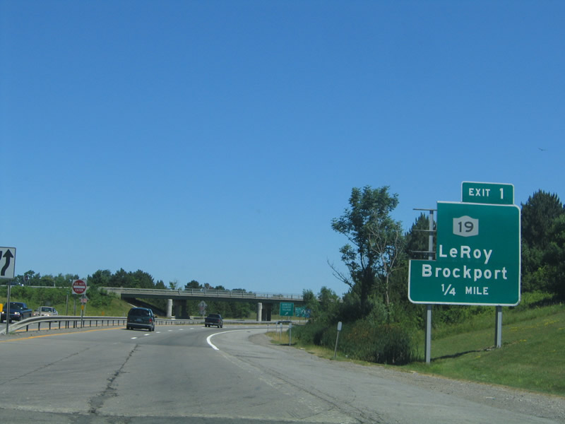
Town Board
Can only act as a body
Town board does not act alone in administering affairs of the town.
Relies on a broad range of boards, bodies and officers to carry out administration of town.
May delegate its day-to-day administrative responsibility to supervisor.

Slide 12
Real Property Tax: Assessment and Collection
How do towns get funds needed
to operate?
State / federal aid
Sales tax, mortgage recording tax
Fees and rents
Real property taxation

Slide 13
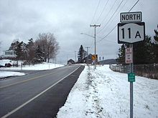
The Real Property Tax Cycle
Towns receive approximately 50% of their revenue through real property tax.
Assessment of property
Assessment roll developed
Budget adopted
Taxes extended and levied
Taxes collected
Assessment of Property
Assessment Roll Developed
Budget Adopted
Taxes Extended and Levied
Tax Collected

Slide 14
Fiscal Administration: Public Deposits
Taxes collected are deposited into banks designated by town board.
Town funds must be collateralized beyond FDIC-insured amounts.
Money not immediately needed may be temporarily invested in accordance with town’s investment policy.

Slide 15
Fiscal Administration
Town board’s powers:
Designate depositories
Establish investment policy
Budget transfers
Approve all contracts / expenditures
Supervisor’s powers:
Custody and care of town funds
Disburse all moneys / execute contracts
Keep accurate books

Slide 16
Highway Administration
Highway superintendent charged with authority to oversee highways.
Repair and maintenance of highways
Snow and ice removal
Machinery and equipment
Town board responsible for appropriating money and establishing policies.
284 Agreement ties these respective powers together.

Slide 17
Planning and Zoning
Town board controls land use within town.
May regulate:
height and size of buildings
density of lots and size of yards
location and use of buildings, structures and land for trade, industry, residence or other purposes

Slide 18
Planning and Zoning
Town Board
Adopts local zoning laws and ordinances
Adopts comprehensive plan
Appoints planning board and ZBA members
Appoints enforcement officer
Planning Board
Powers delegated by town board
May help prepare comprehensive plan and special use permits
Site plan review and subdivision review
Zoning Board of Appeals
Mandatory in towns with zoning
Variances
Zoning law / ordinance interpretation
Appeals
Code Enforcement Officer
Enforces zoning laws as written (investigate compliance / violations)
Issues permits

Slide 19
Permits and Records
Town board may authorize a number of activities through use of a permit.
Permits are often issued by the town clerk.
Permits must be issued in accordance with terms set by town board.

Slide 20
Permits and Records
Town clerk’s office serves as repository of all town documents and records not needed by other officers for conduct of business.
Minutes of town board meetings, local laws, employment policies, etc. all get filed with town clerk.
Town clerk is records management officer and may be records access officer.

Slide 21
Personnel Administration
Town board has power of appointment of all officers and employees, except as otherwise provided by law. For example:
Highway superintendent appoints highway crew
Principals appoint deputies
Town board sets salaries, employment policies
Department heads and / or town supervisor typically provide day-to-day supervision

Slide 22
Personnel Administration
Prior to making any personnel decision, always check your:
Employment policies
Civil Service Rules (administered by county)
Collective Bargaining Agreements

Slide 23
Miscellaneous Administration
Animal control: towns responsible for licensing and control of dogs (animal control officer / town clerks)
Police: towns may establish police departments, and regulate its government, discipline and administration (town board / police commissioners).
Recreation: towns may undertake a number of programs for youth and recreation (town board / recreation commission).
Improvement districts: town boards will be responsible for administration of most improvement districts.

Slide 24
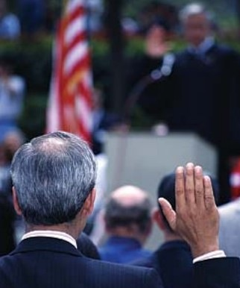
First Actions in Office
All town officers are required to take and file an oath of office within 30 days of the commencement of the term of office for which he or she was chosen
Certain town officers are required to execute and file an official undertaking within 30 days of the commencement of the term of office for which he or she was chosen
If not executed and filed within 30 days, the office will be deemed vacant.

Slide 25
Association of Towns of the State of New York (AOTSNY)
A membership association of town governments established by town officers in 1933 to help towns obtain greater economy and efficiency.

Slide 26
AOTSNY Services and Resources
Legal and technical assistance
Representation with state and federal government
Insurance (liability, property, workers’ compensation)
Training
Annual meeting
Finance school
Highway school
Planning and zoning school
New officials school

Slide 27
AOTSNY Services and Resources
Publications
Directory Of Town Officials - published bi-annually. Contains names, addresses, phone, and fax for more than 15,000 town officials. Information on all 932 towns in New York State.
Talk Of The Towns/Topics - the association magazine for town officials about town government and related issues. Published bi-monthly.
Laws Digest - the annual summary of new laws affecting town government.
Training manuals - written by our technical and legal staff (who have years of experience in town government) and designed to keep town officials updated and informed about the responsibilities of their offices. These comprehensive "how-to" manuals have been a technical informational resource for new and veteran town officials alike.

Slide 28
AOTSNY Training Manuals
The Town Law Manual (2006)
The Office of Town Highway Superintendent (2005)
The Office of Town Clerk (2013)
Tax Collection in Towns (2008)
Forms and Outline of Criminal Procedure for Town Justices and Police (2006)
Suggestions for Procedures at the First Meeting of the New Town Board (2012)
Small Claims Guide for Towns & Village Courts(2009)

Slide 29
Questions & Comments?
Association of Towns of the State of New York
150 State Street
Albany, New York 12207-1671
Phone: (518) 465-7933
http://www.nytowns.org

